Slide 1



GLOBAL ONLINE ORDERS PROJECT USING SQL

Slide 2
INTRODUCTION TO THE PROJECT
This project focuses on analyzing a relational database that captures various aspects of a fictional company's operations, including products, customers, employees, and orders. By using SQL queries, we aim to extract valuable insights from the data, such as sales trends, customer behaviors, and employee performance. The findings will help inform strategic decisions and improve overall business efficiency. This analysis serves as a practical application of data management and analytics in a real-world context.

Slide 3
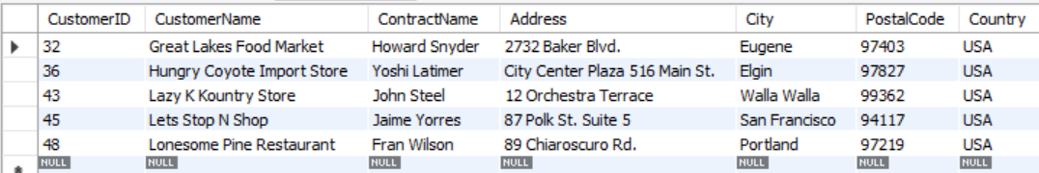
Find all customers from USA ?

Slide 4
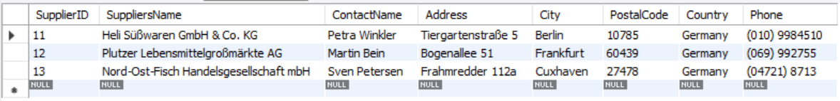
Find all suppliers from a specific country?

Slide 5
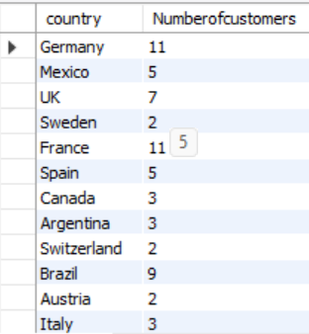
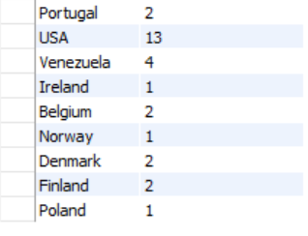
Find the total number of customers in each country?

Slide 6
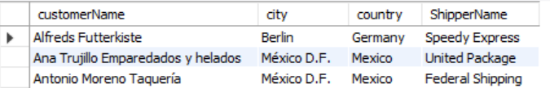
Find the details of customers and the shippers they use?

Slide 7
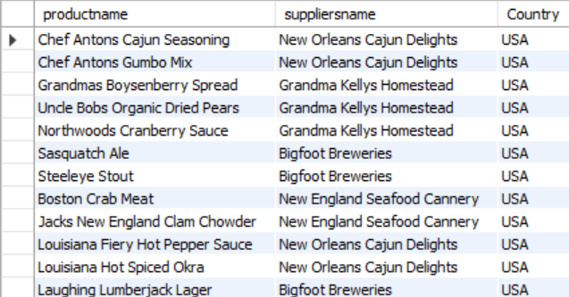
Get the suppliers who provide products in the USA?

Slide 8
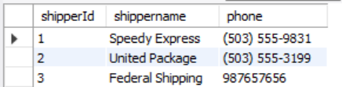
Find the shippers and their contact details?

Slide 9
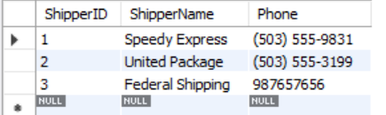
Update the contact phone of a supplier?

Slide 10

How many customers are there in the database?

Slide 11

what are all the products available?

Slide 12
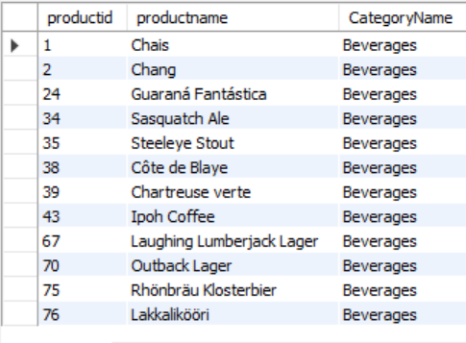
Which products belong to the 'Beverages' category?

Slide 13
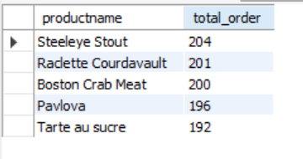
What are the top 5 products by total quantity ordered?

Slide 14
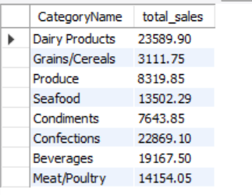
What is the total sales amount for each product category?

Slide 15
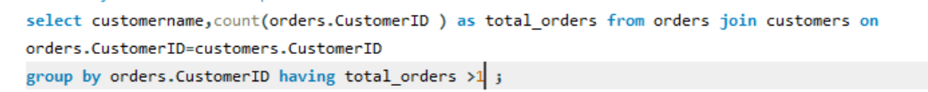
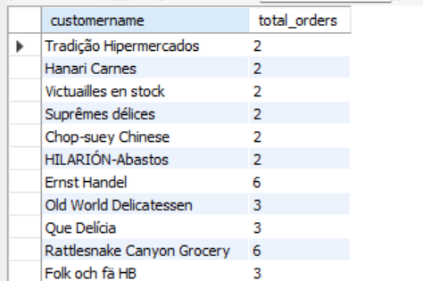
How many customers have placed more than one order?

Slide 16
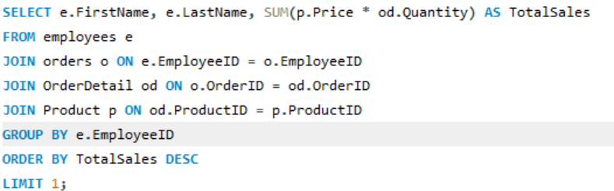
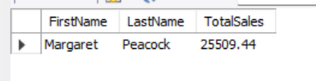
Which employee has the highest total sales amount ?

Slide 17
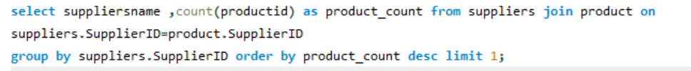

Which supplier provides the highest number of products?

Slide 18
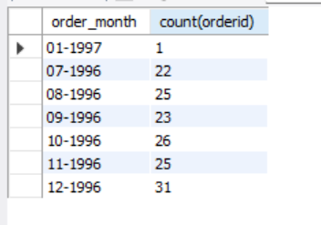
How have orders changed over the months? Provide the total number of orders per month.?

Slide 19
THANK YOU!
KISHAN GUPTA

